Slide 1

E-Commerce Clothing Sales Analysis

Slide 2
INTRODUCTION
E-Commerce encompasses any commercial transaction that involves the transfer of information across the internet.
While there are many ways to sell to consumers over the internet, the main advantage of online selling is you can sell to consumers anywhere, anytime. You can meet the customer where and when they’re shopping.

Slide 3
Objective
Interpret the data:
1. Find out the products sales base on gender
2. What is the total product sales categorize by color
3. What is the top 20 products
4. What is the top 20 products base on category
5. Does Merchants uses product ad boost for the Top 20 products
6. Find out the Top 20 products price base on category
7. What is the product’s rating for Top 20 products
8. What is the merchant’s rating for Top 20 products
Given recommendation to new seller to help them start up their business with the data collection from the analysis.

Slide 4
Source of Dataset
Summer clothing sales dataset from Wish platform
https://www.kaggle.com/datasets/jmmvutu/summer-products-and-sales-in-ecommerce-wish

Slide 5
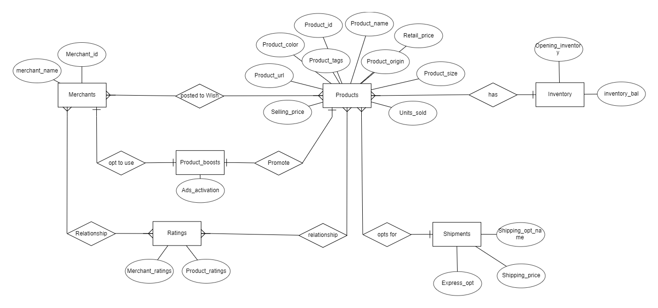
Entity Relationship Diagram

Slide 6
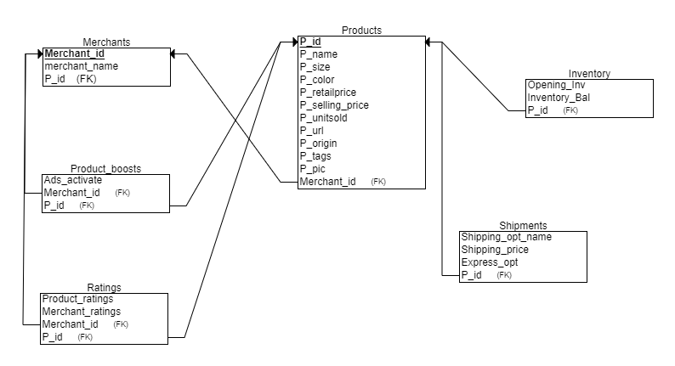
Relational Schema

Slide 7
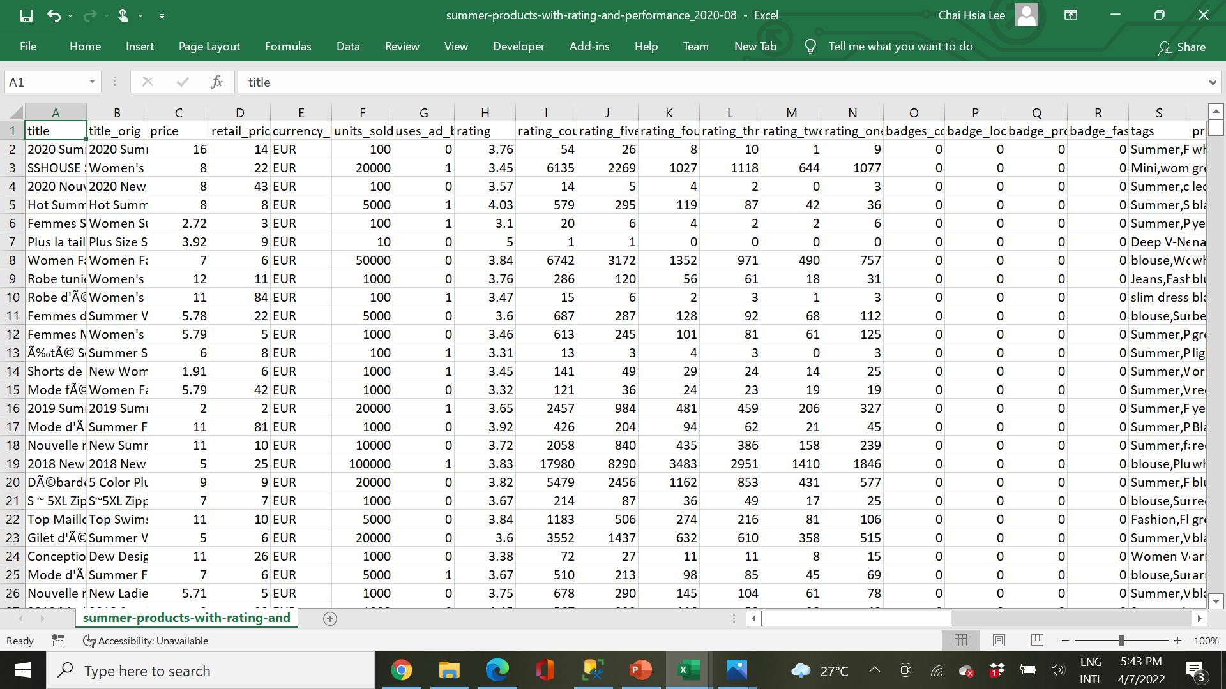
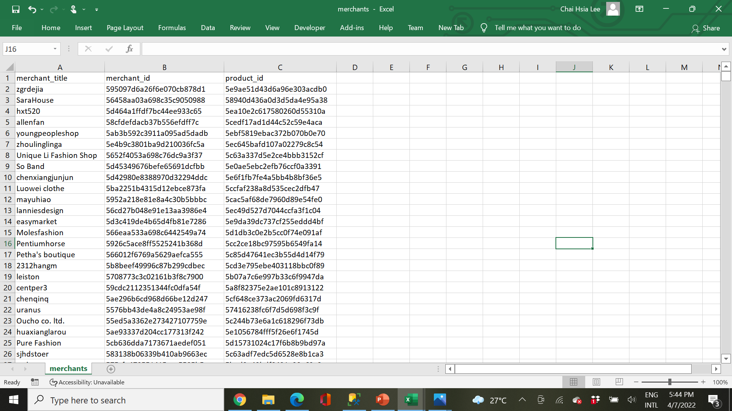
Normalising The Dataset
Master sheet
Split data from Master sheet into Merchant Table

Slide 8
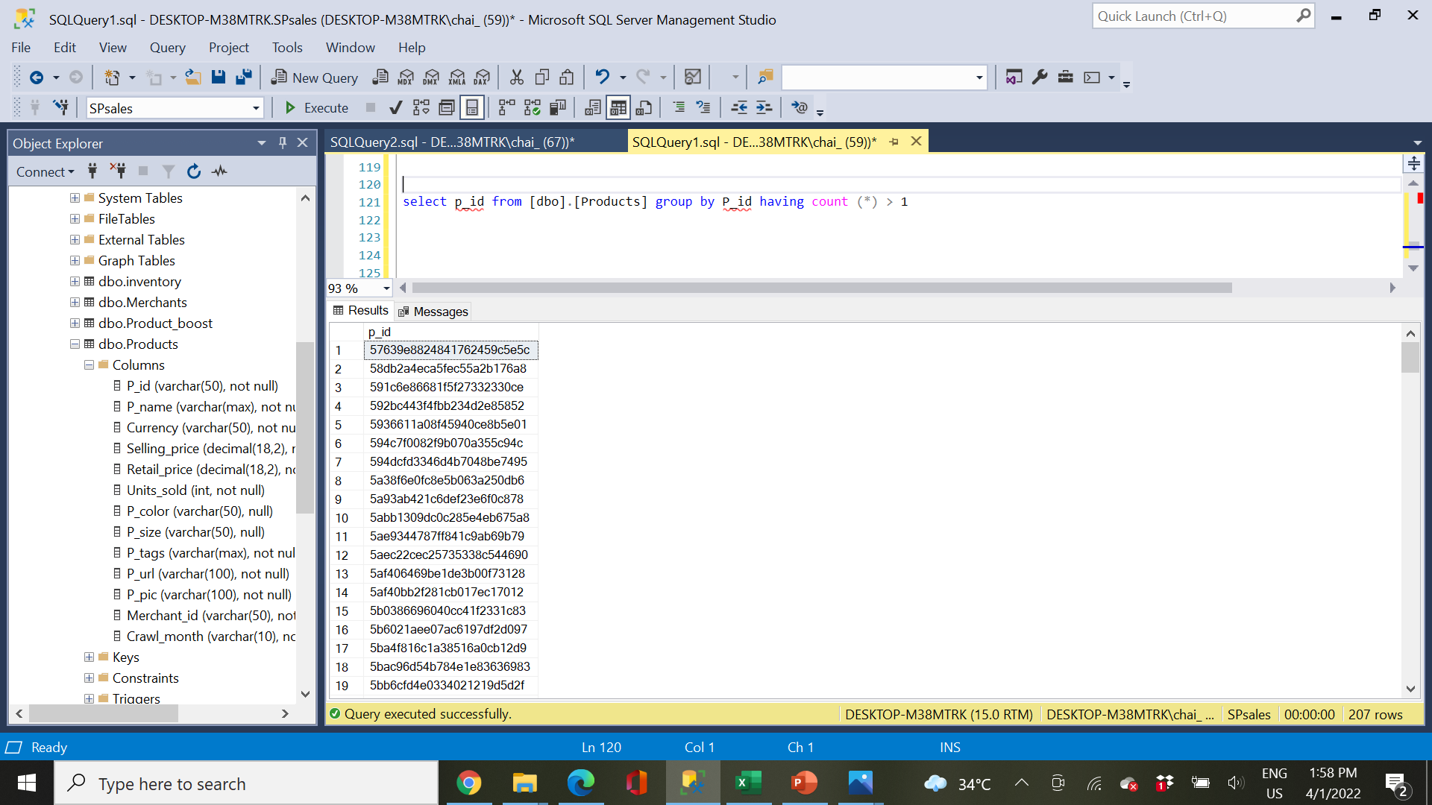
Data Cleaning
Checking duplicate data, found 207 row duplicate

Slide 9
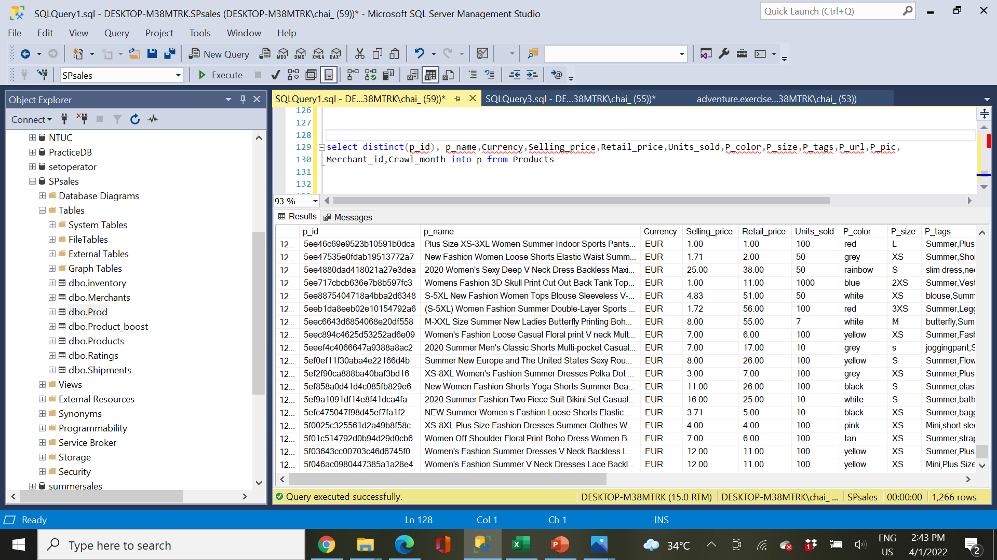
Data Cleaning
Remove duplicate data

Slide 10
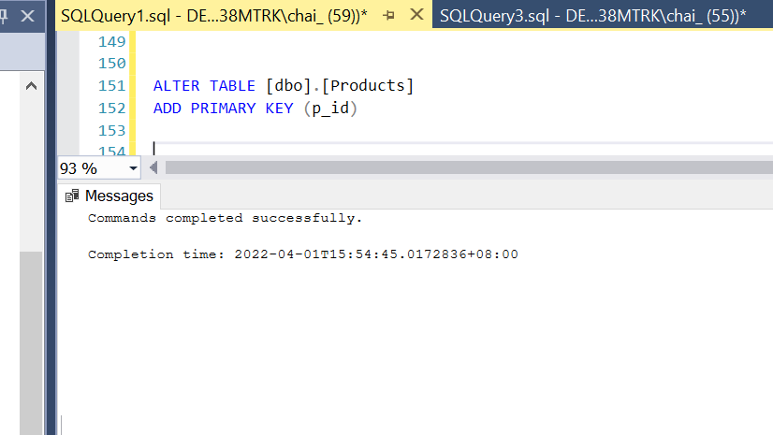
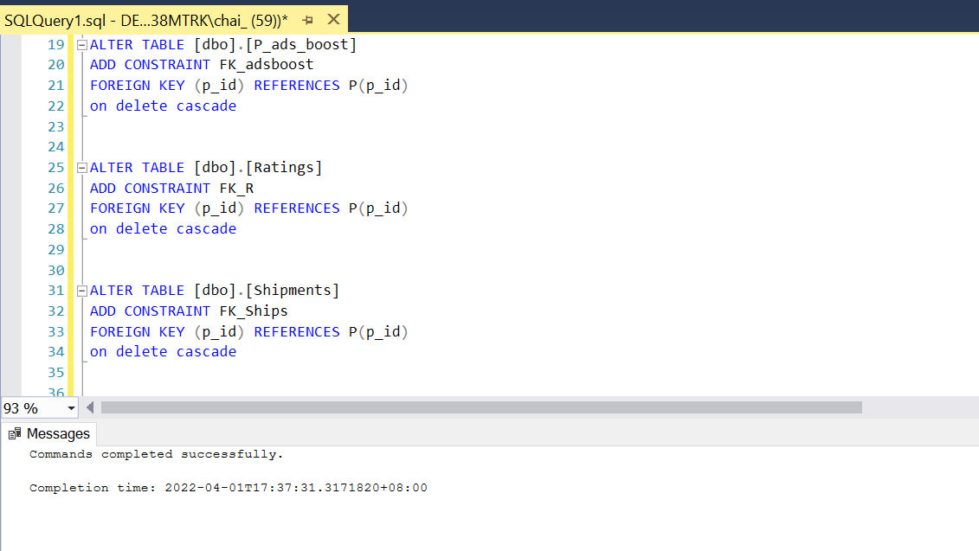
Data Cleaning
Add Foreign Key
Add Primary Key

Slide 11
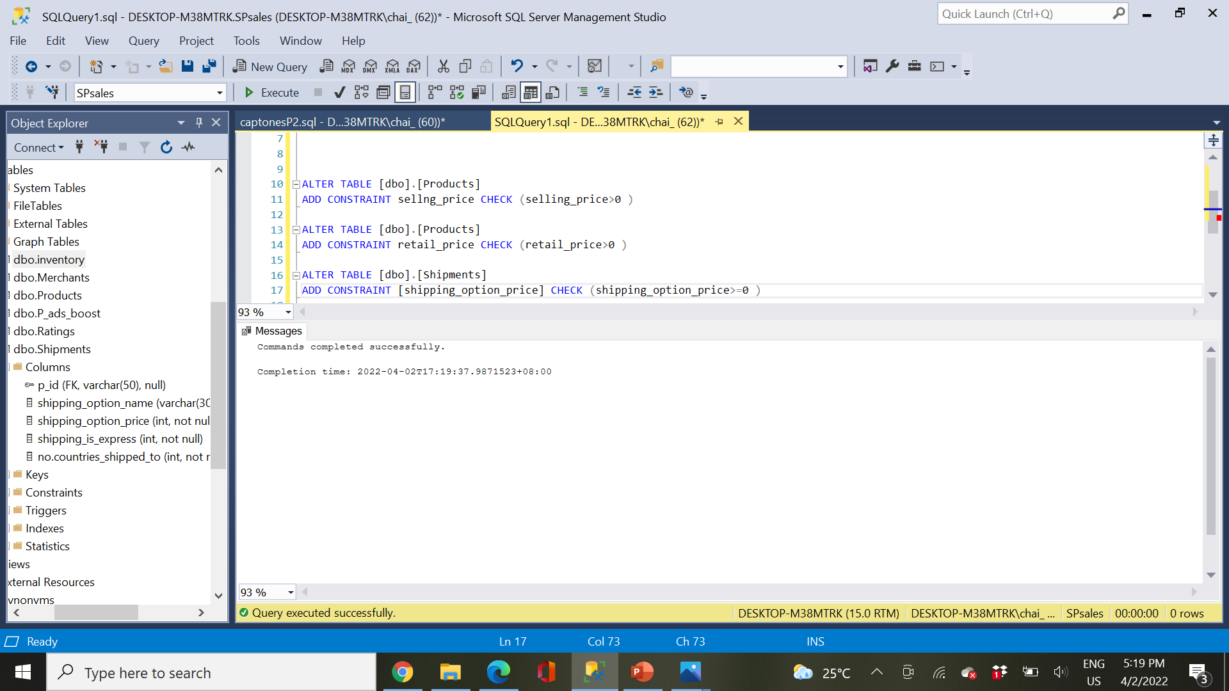
Data Cleaning
Checking Selling price, retail price and shipping price

Slide 12
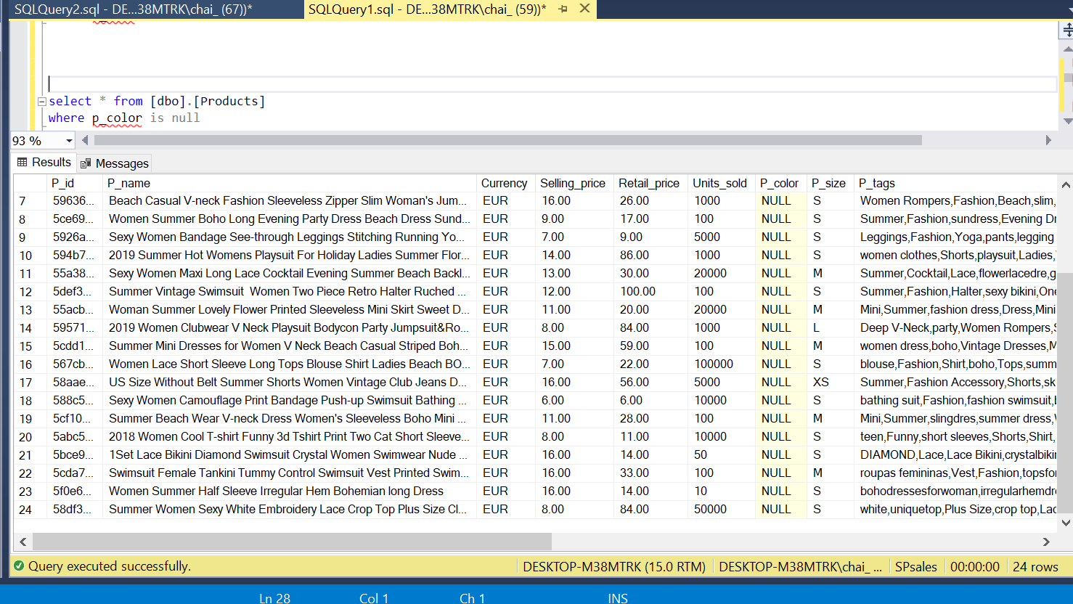
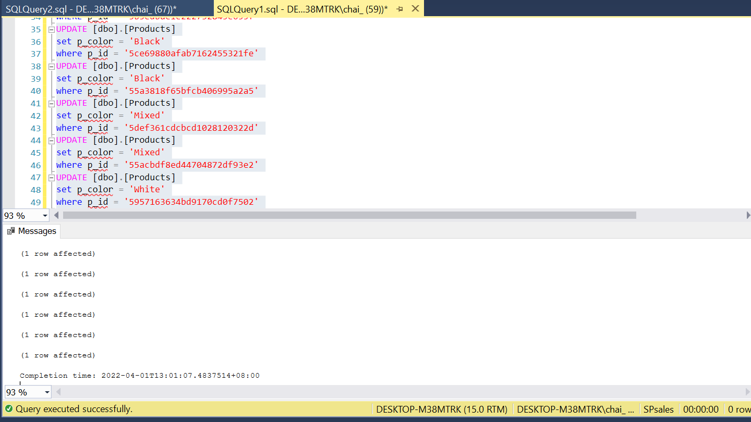
Data Cleaning
Checking null value for product’s color
Update color base on Product Picture

Slide 13
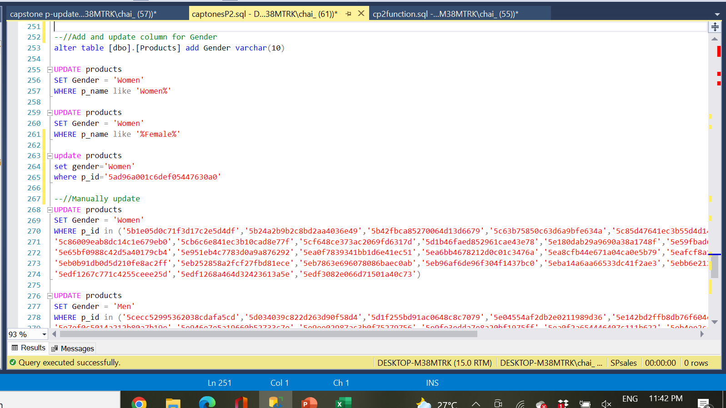
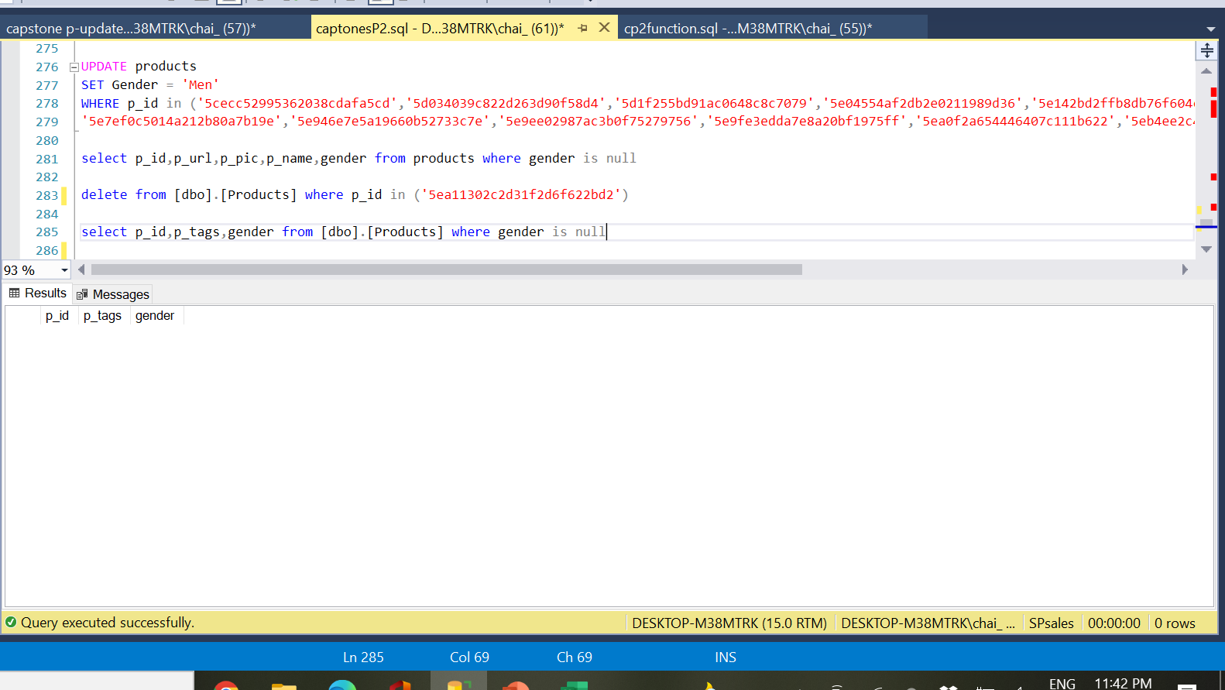
Data Cleaning
Add and update column for Gender

Slide 14
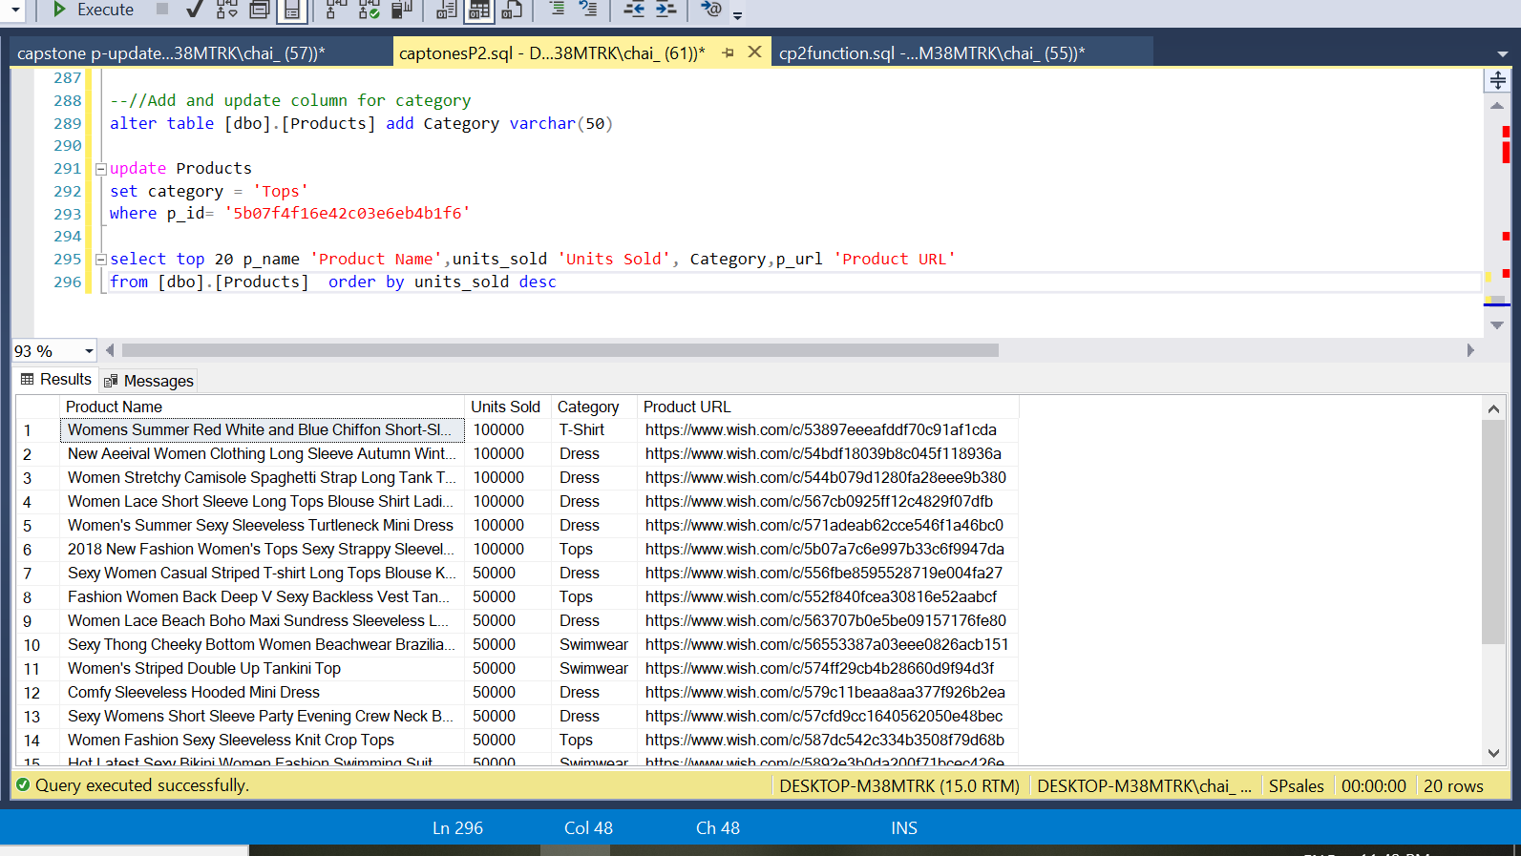
Data Cleaning
Add and update column for product category

Slide 15
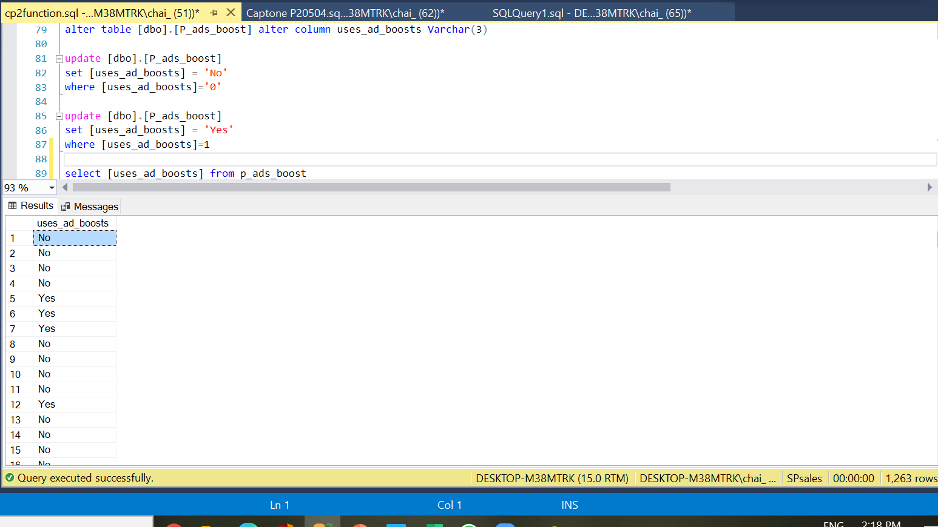
Data Cleaning
Update Product ad boost status from 0 to No and 1 to Yes

Slide 16
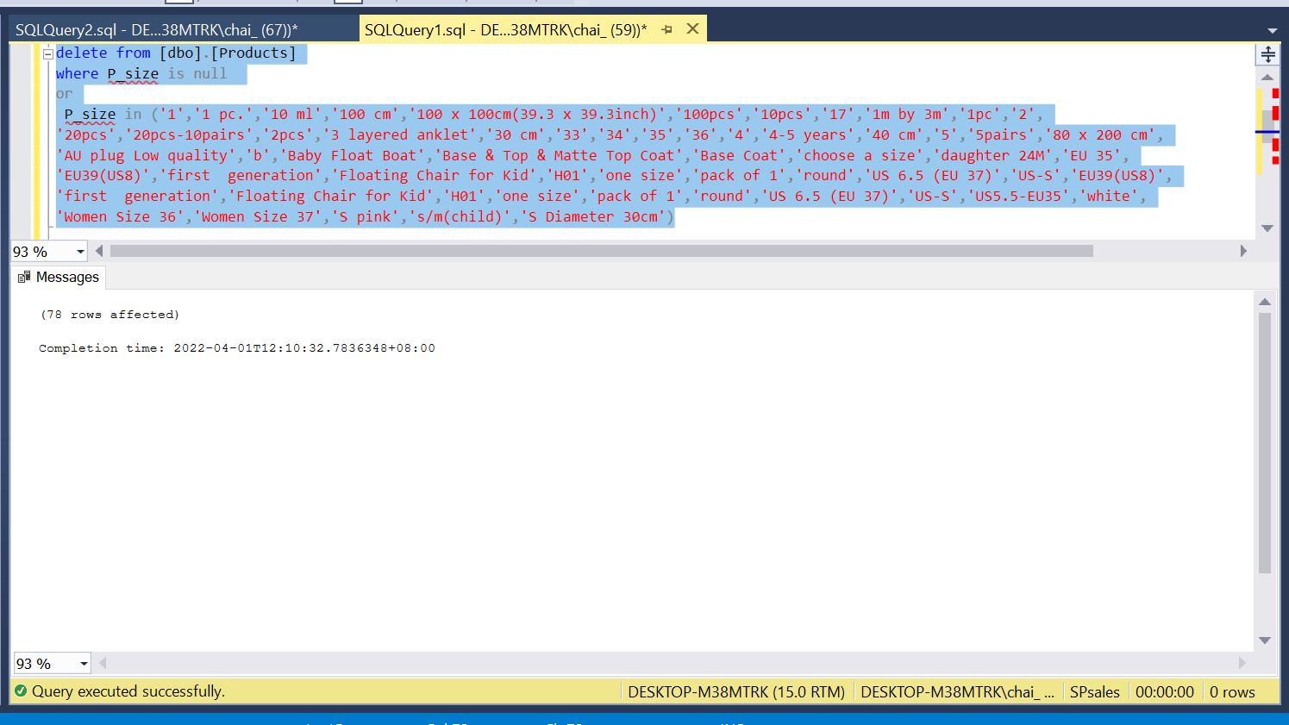
Data Cleaning
Remove irrelevant data base product’s size

Slide 17
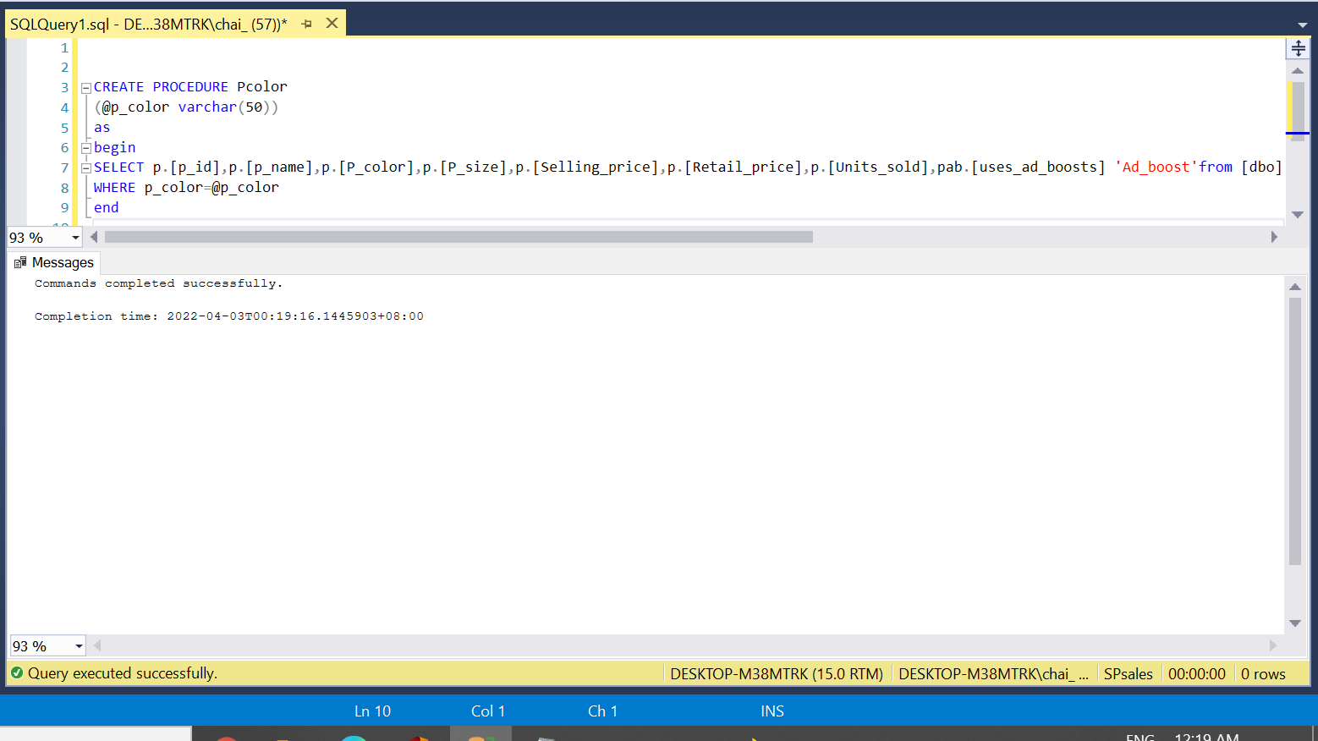
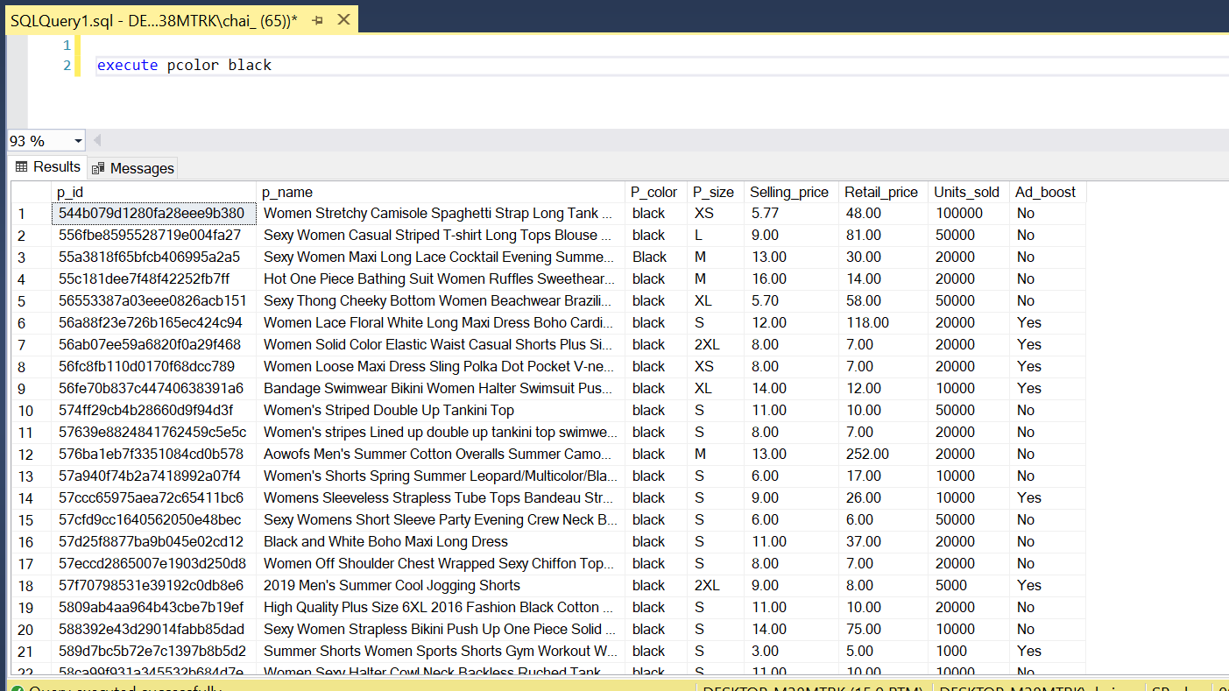
Data Cleaning
Create Procedure for product color
Display color by executing the procedure

Slide 18
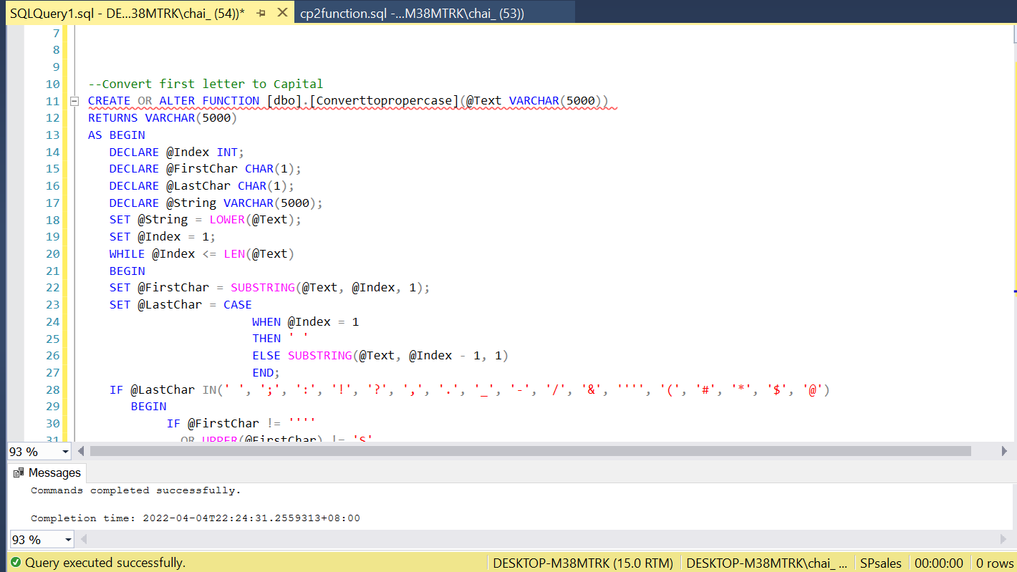
Data Cleaning
Create function to convert first letter to capital letter

Slide 19
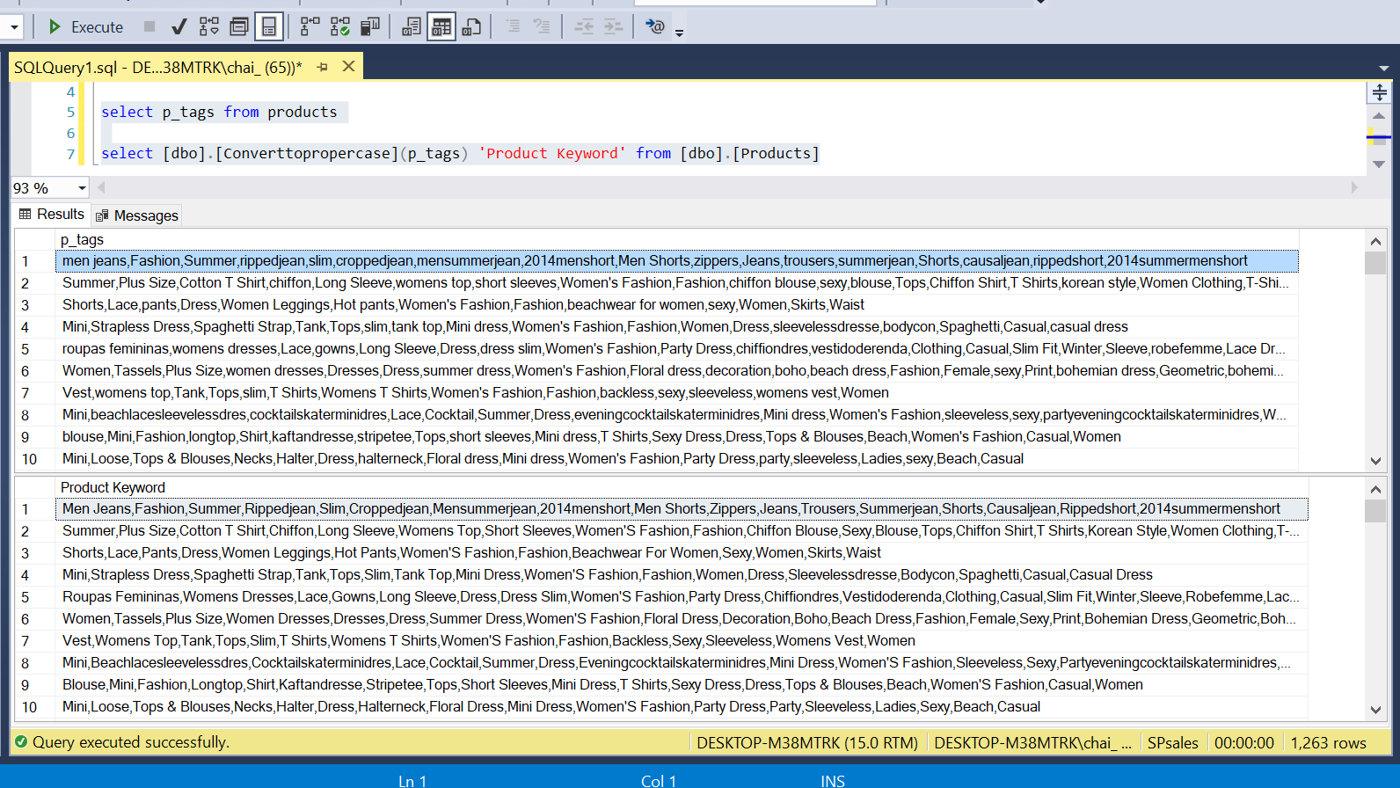
Data Cleaning
Display proper case function

Slide 20
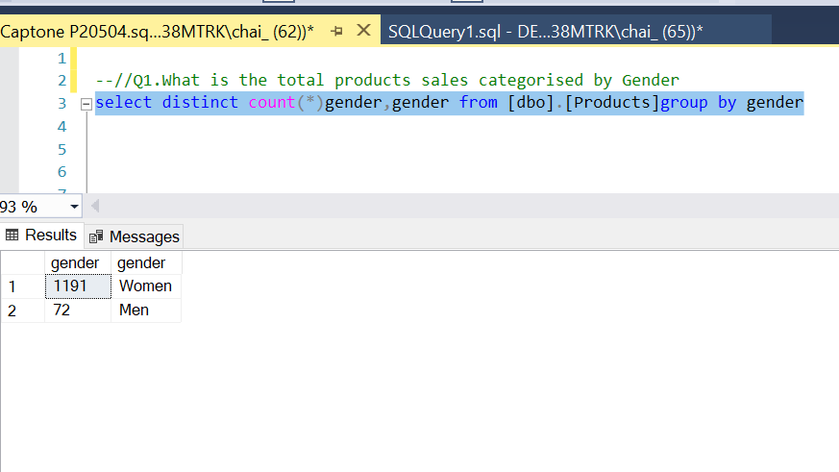
Data Analysis
Analysis 1: Find out the products base on gender

Slide 21
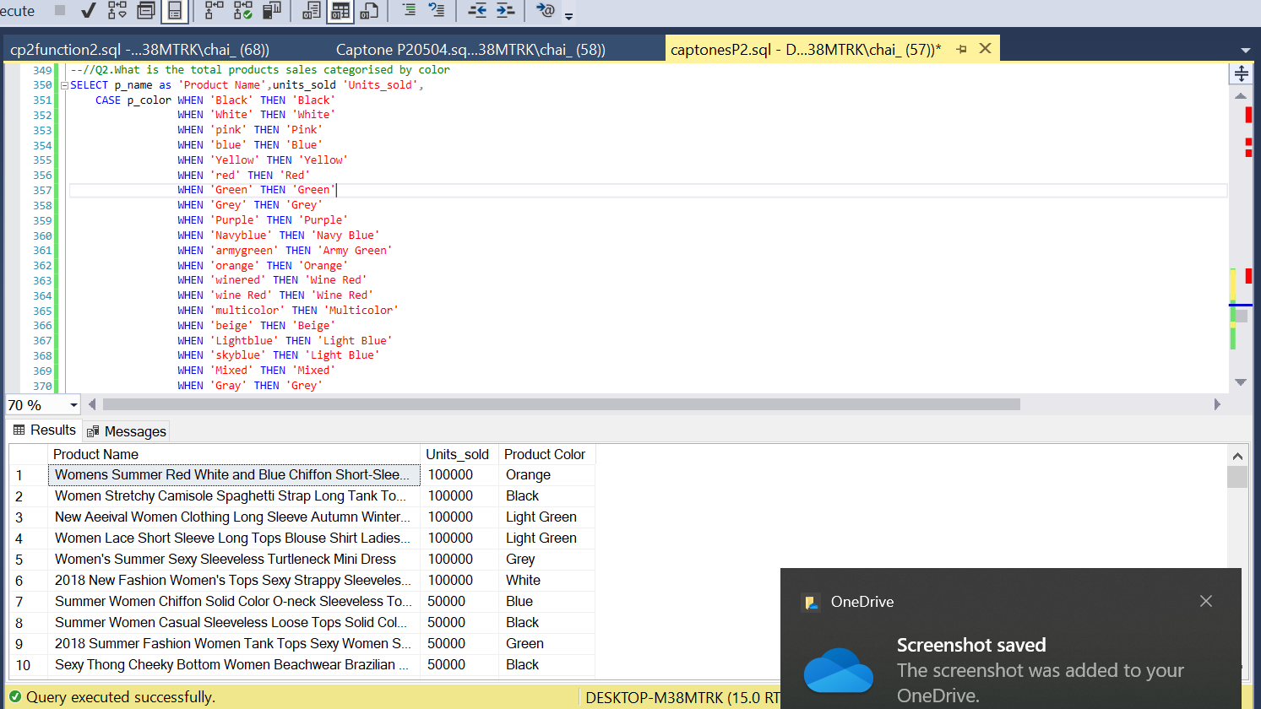
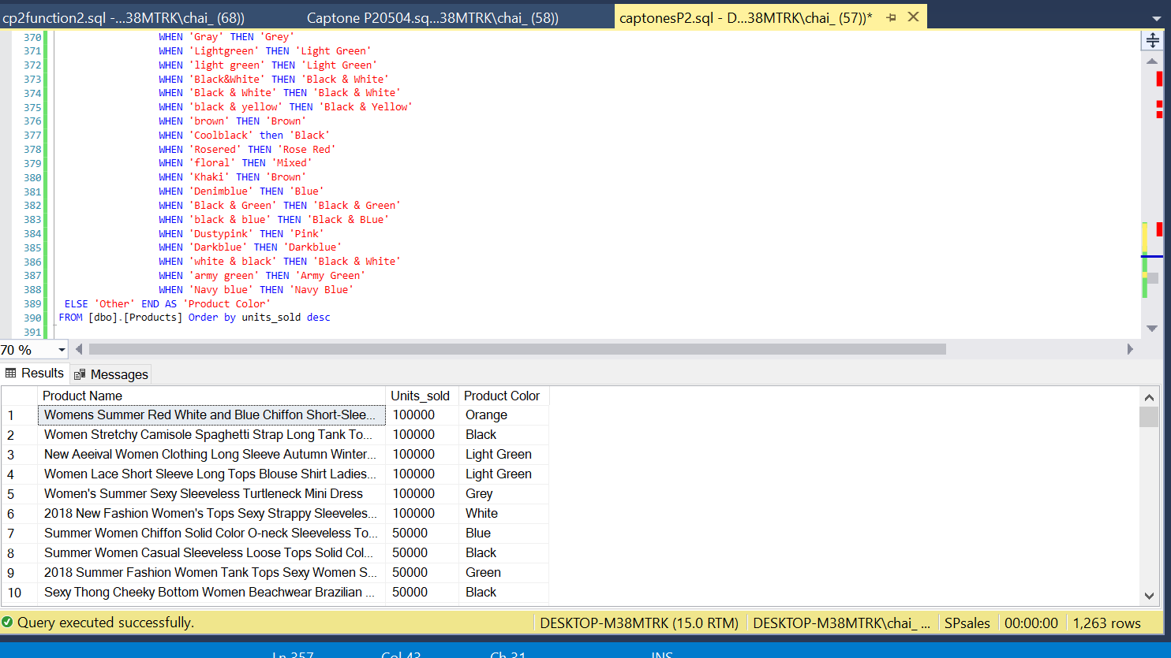
Data Analysis
Analysis 2: What is the total product sales categories by color

Slide 22
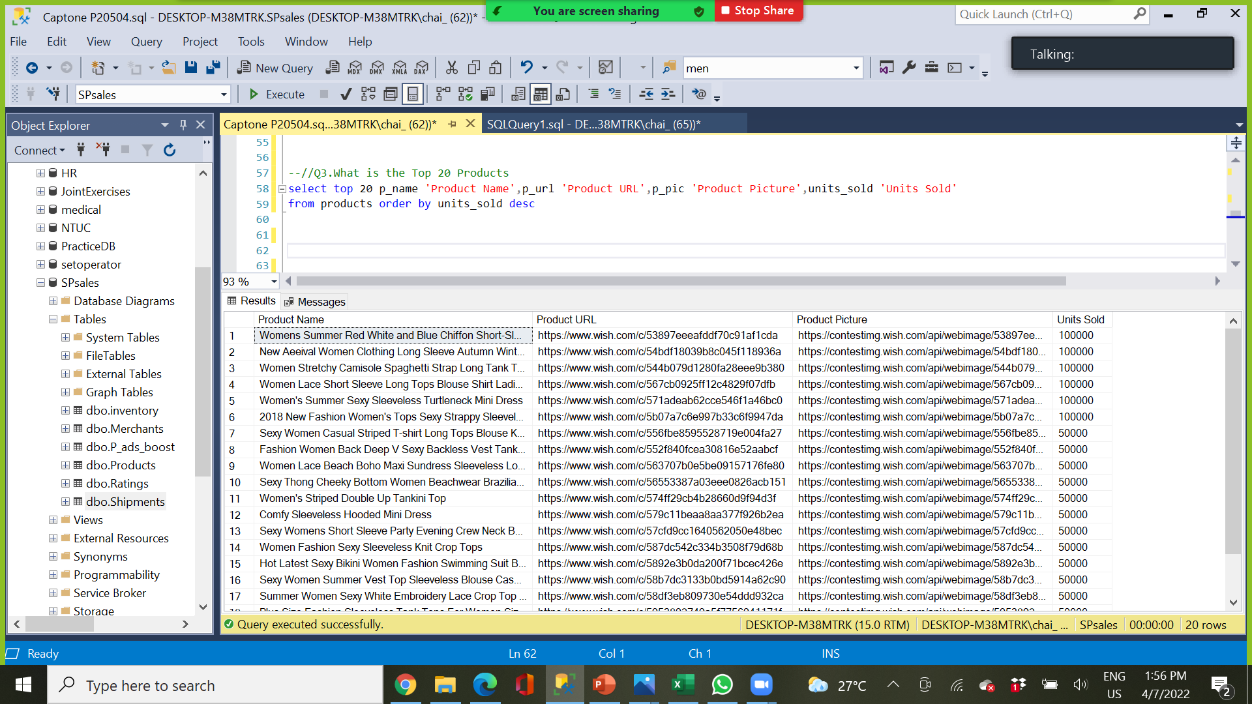
Data Analysis
Analysis 3: Find out what is the top 20 products

Slide 23
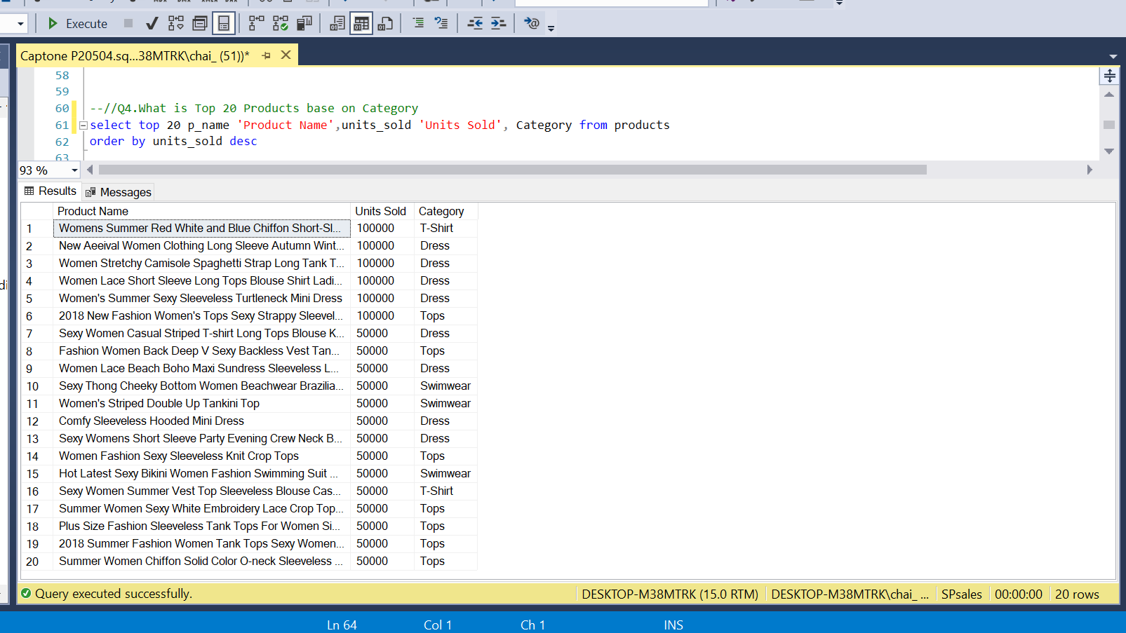
Data Analysis
Analysis 4: Find out the top 20 products base on category

Slide 24
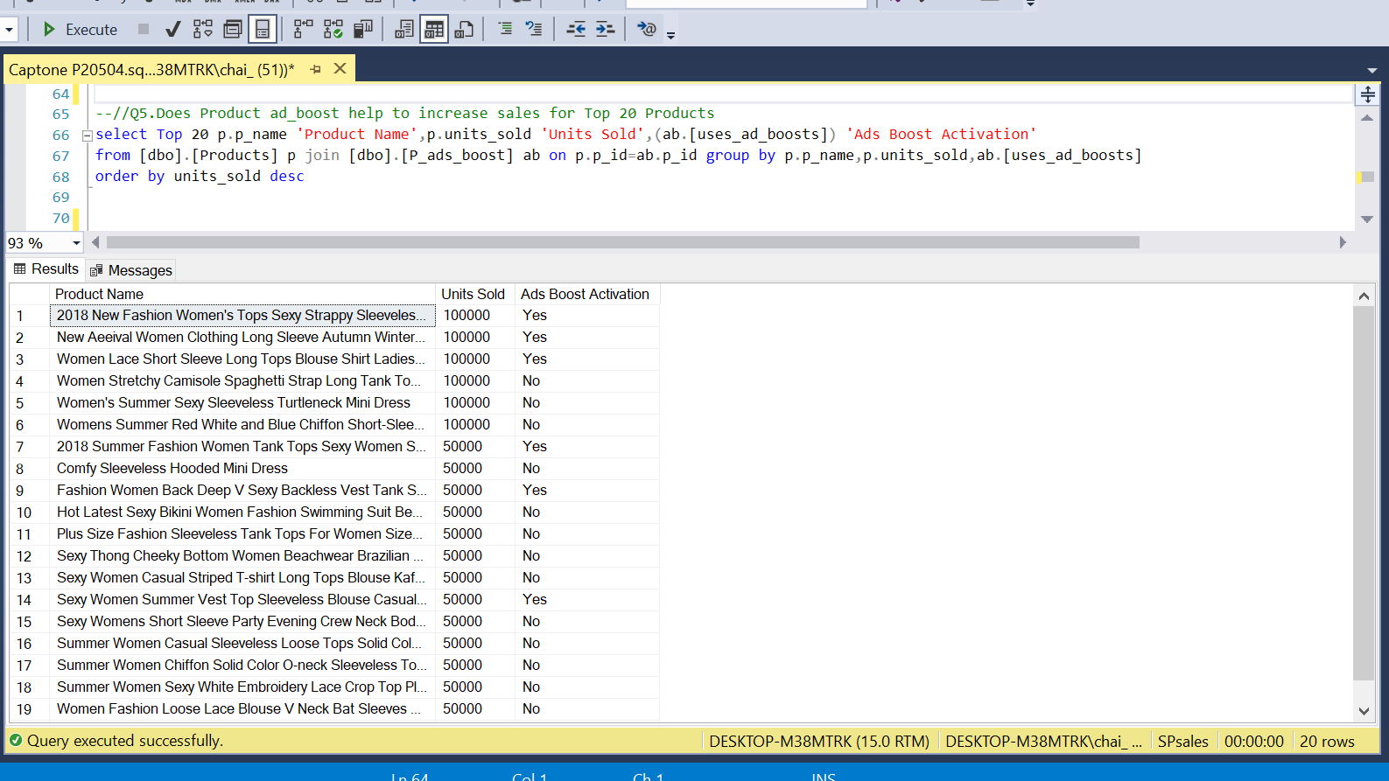
Data Analysis
Analysis 5: Find out product ad boost for the Top 20 products

Slide 25
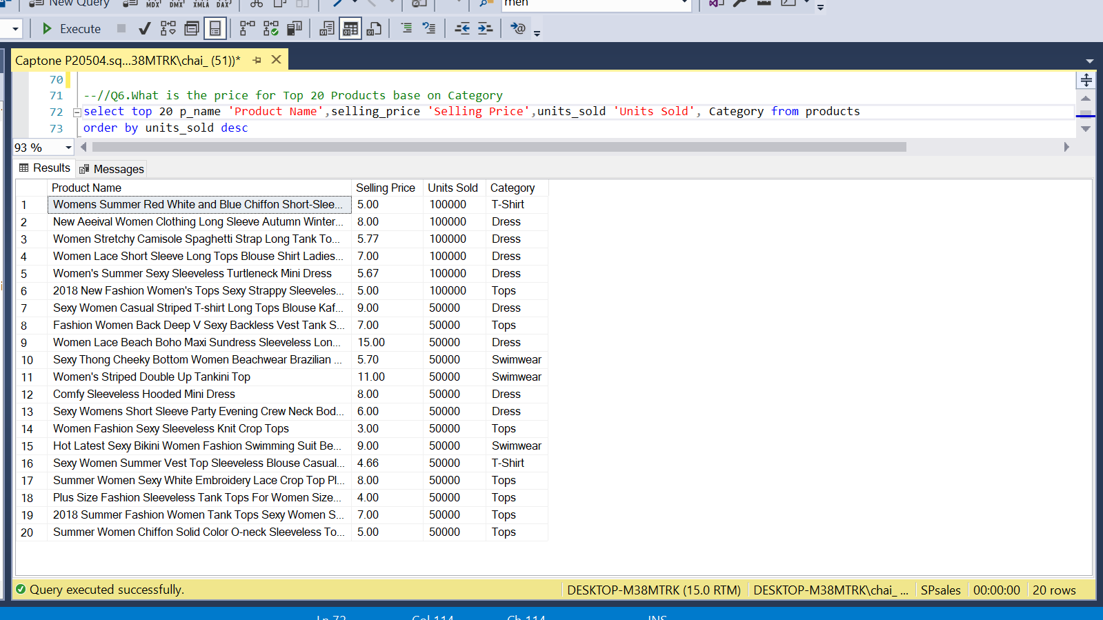
Data Analysis
Analysis 6: Find out the Top 20 products price base on category

Slide 26
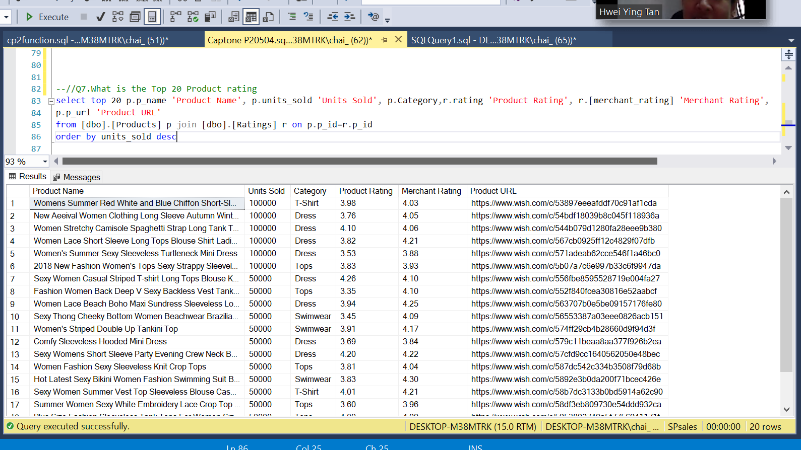
Data Analysis
Analysis 7: Find out the product’s rating for Top 20 products

Slide 27
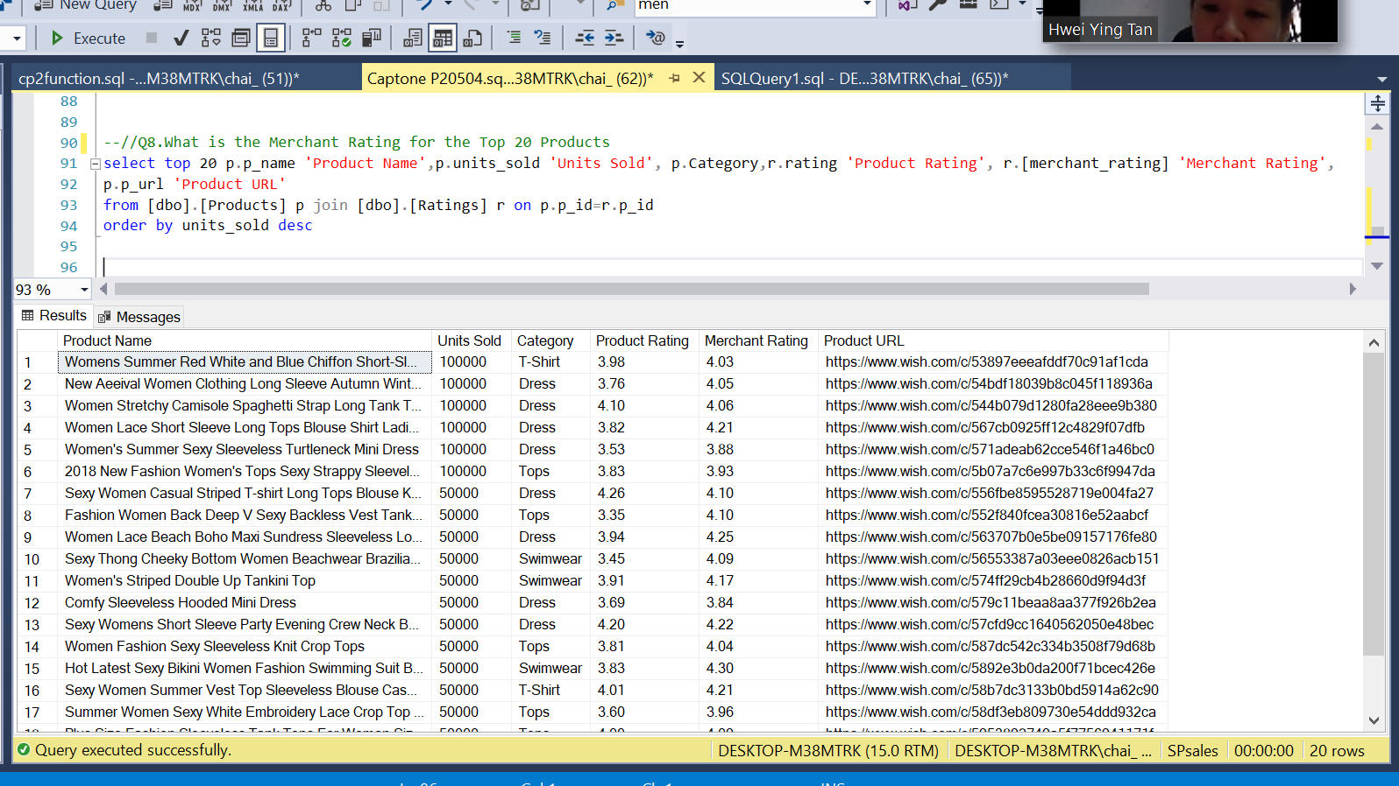
Data Analysis
Analysis 8: Find out the merchant’s rating for Top 20 products

Slide 28
Conclusion
Women clothing have higher demand than men clothing.
Dress ,tops and t-shirt for top 20 products was simple and nice.
Best selling clothing is in black color(1,480,843 pcs) and white color (1,027,711 pcs).
Highest sales base on category is dress (600,000pcs), tops (400,000pcs).
Only 6 out of 20 of the top 20 products uses product ad boost to promote their products.
The highest product price is dress, swimwear, tops and t-shirt, respectively.
Top 20 Products have high product and merchant rating which align to their ranking.

Slide 29
Recommendation
Focus more on women’s clothing since it is on high demand.
Between the different type of ladies apparent, choose casual and simple dress, tops and t-shirt.
Clothing in black and white color need to included in the selling list if they are available.
Add Product ads boost, because it increases the exposure of your products and gets them in front of the customers who are most likely to buy them.
Pricing decisions - Set the price according to the main competitor’s price.

Slide 30
Recommendation
Maintain high product and merchant rating because rating and reviews are the number one online feature shoppers rely on when making informed product decisions faster.

Slide 31

THANK YOU

